Slide 1









Cyber-
SecureHub
Integrating Cyber-Security Tools

Slide 2






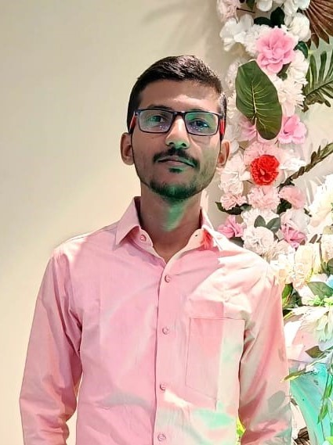
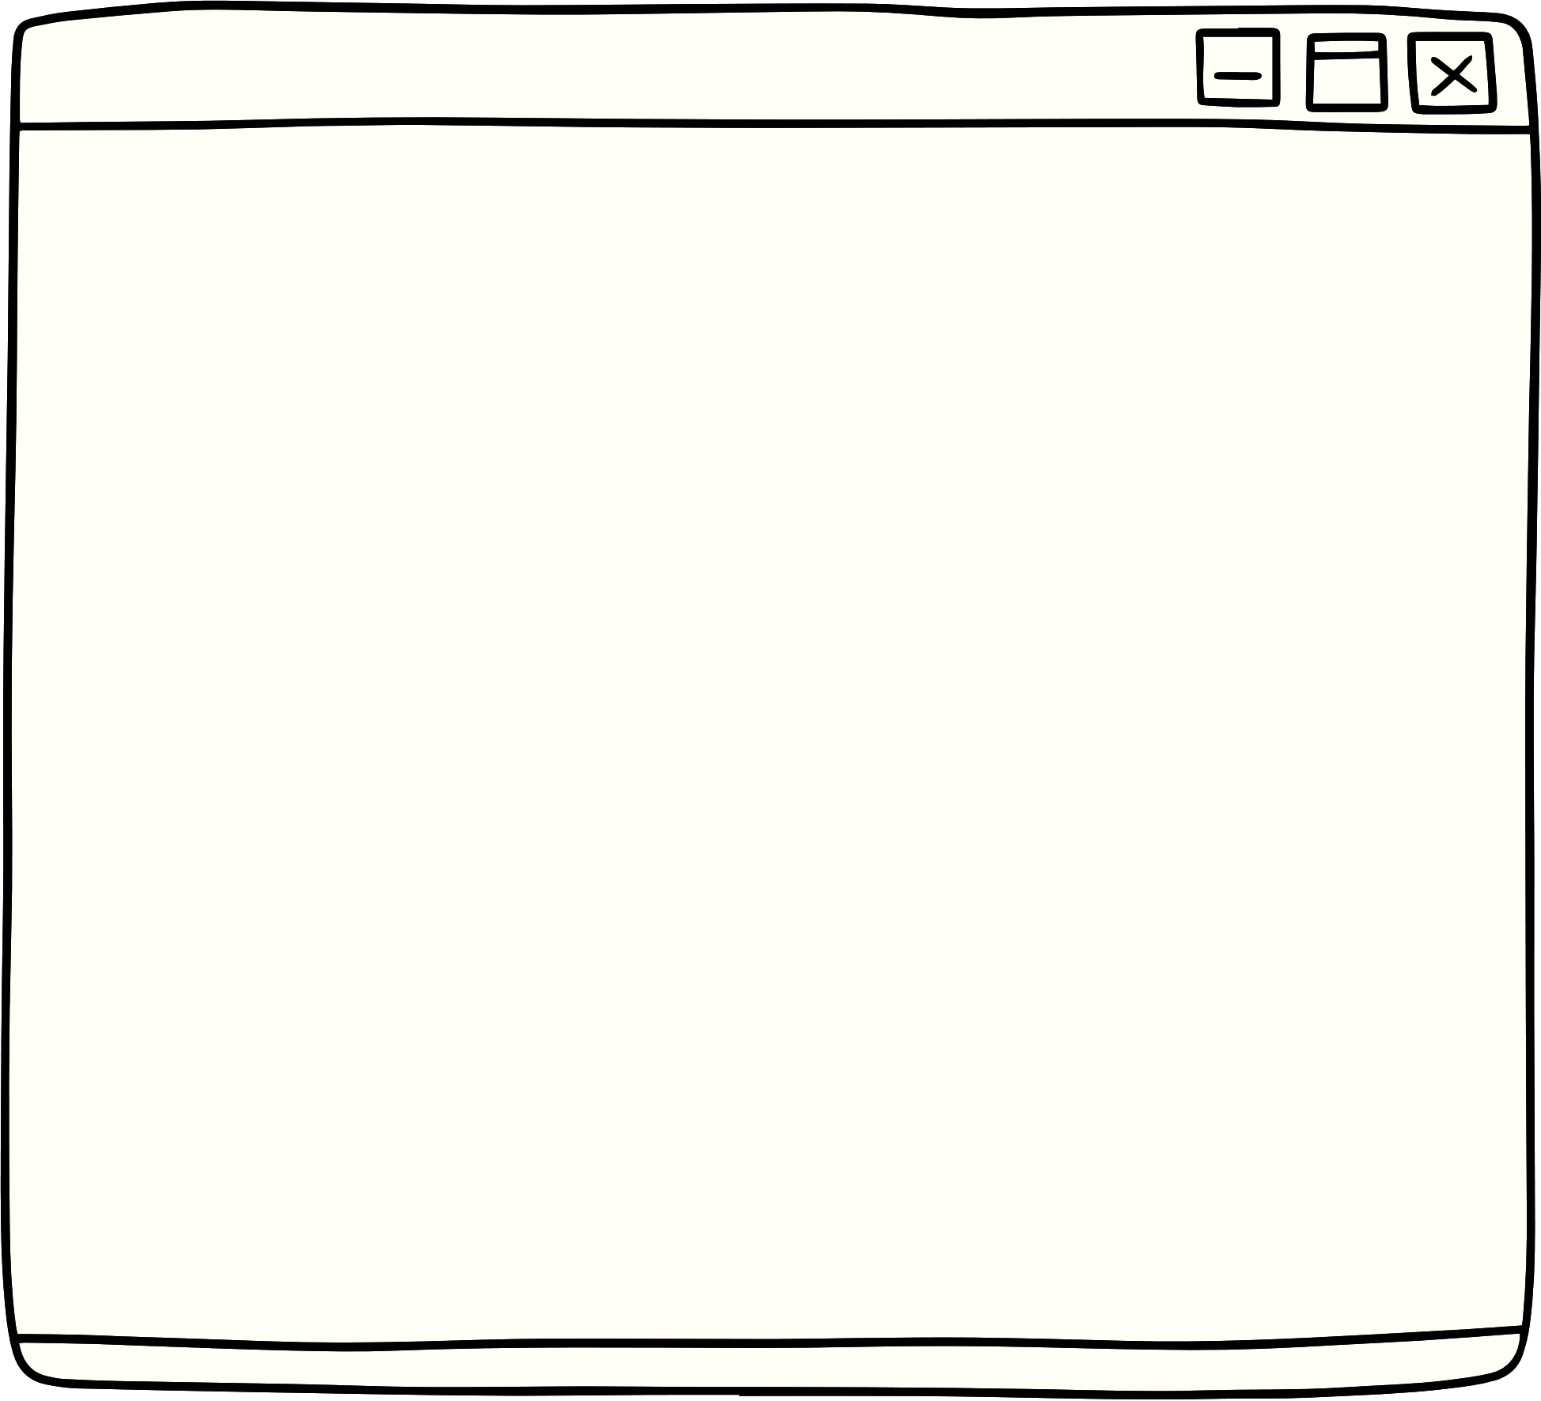

Under Guidance
Harsh Pardeshi
Suyog Waghere
Seat No. – B190933419
Group No. - 06
Seat No. – B190933429
Group No. - 06
Prof.M.D.Karad
Shrinad Patil
Krunal Kurhe
Seat No. – B190933424
Group No. - 06
Seat No. –
Group No. - 06
Department of AIML Engineering, LoGMIEER, Nashik

Slide 3



Contents
01
02
03
04
Introduction
Objectives
Literature Survey
Problem Statement
05
06
07
08
Software And Hardware Requirements
Proposed System Architecture
Mathematical Model
UML Diagram
Department of AIML Engineering, LoGMIEER, Nashik

Slide 4
Contents
09
10
11
Test Cases
Proposed GUI
Project Plan
12
13
Conclusion
References
Department of AIML Engineering, LoGMIEER, Nashik

Slide 5


Introduction
What:
Addressing evolving cyber threats and ethical hacking challenges.
Why:
To explore ethical dimensions in cybersecurity.
Department of AIML Engineering, LoGMIEER, Nashik

Slide 6
Objectives
ENCOURAGE COLLABORATION AMONG ETHICAL HACKERS AND SECURITY EXPERTS
CREATE BETTER CYBERSECURITY TOOLS
IMPROVE DIGITAL DEFENSE STRATEGIES
RAISE AWARENESS ABOUT CYBERSECURITY
Department of AIML Engineering, LoGMIEER, Nashik

Slide 7
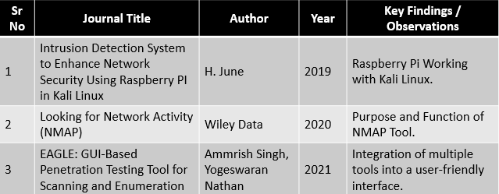
Literature Survey
Department of AIML Engineering, LoGMIEER, Nashik

Slide 8
Problem Statement
In Today's Fast-changing Digital World, Countering New Cyber Threats And Ethical Hacking Challenges Is Crucial. We Need To Tackle These Issues To Keep Digital Systems Secure, Safeguard Sensitive Data, And Maintain User Trust.
Department of AIML Engineering, LoGMIEER, Nashik

Slide 9




Software And Hardware Requirements
Software
Hardware
Front End: React JS
Bank End: Node JS (Express JS)
VS Code
Postman
Figma
Raspberry Pi 4 Model B
Wi-Fi Router with Static IP
Department of AIML Engineering, LoGMIEER, Nashik

Slide 10

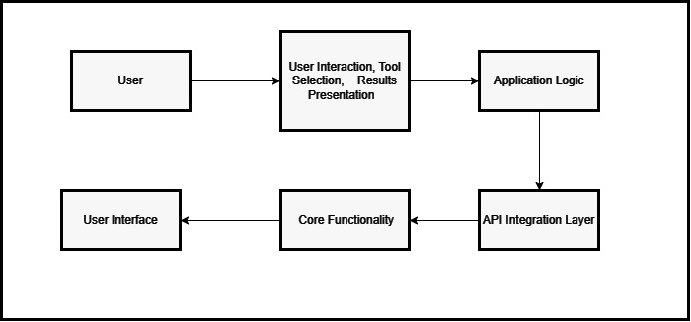


Proposed System Architecture
Department of AIML Engineering, LoGMIEER, Nashik

Slide 11
Mathematical Model
S = { I, O, Fuser, Fadmin, H/Wreq , S/Wreq, NP, Success, Failure }
Where, S: Represents the System.
I: Represents Input to the system.
O: Represents Output from the system.
H/Wreq: Represents Hardware Requirements.
S/Wreq: Represents Software Requirements.
NP: Stands for Needs and Preferences.
Success, Failure: Indicate different states of the system.
Department of AIML Engineering, LoGMIEER, Nashik

Slide 12
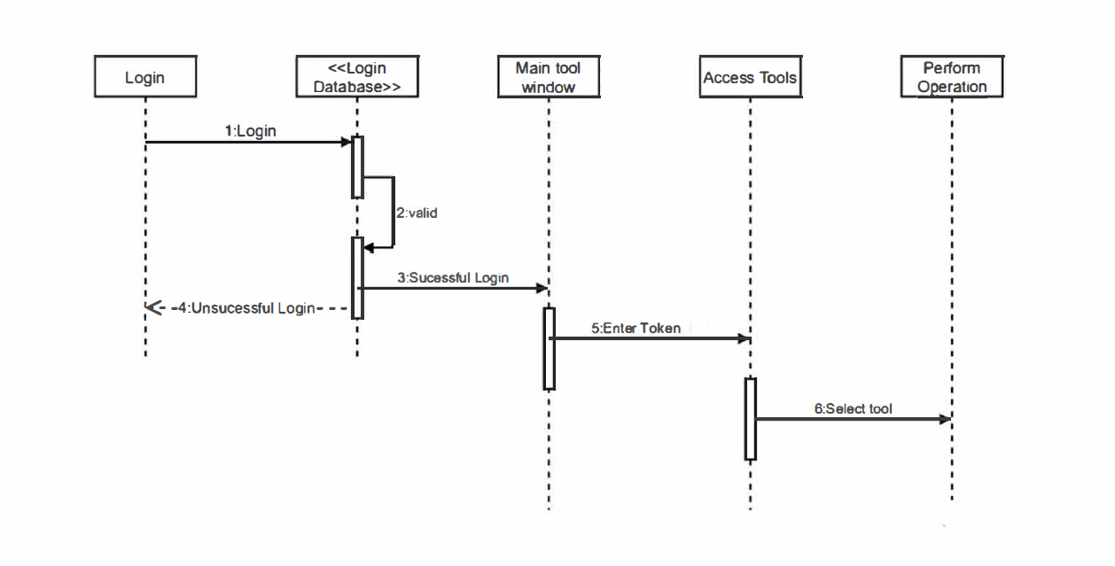
UML Diagram
Department of AIML Engineering, LoGMIEER, Nashik

Slide 13

Test Cases
Test Case 1: Verify That Users Can Register For An Account
Test Case 2: Verify That Users Can Log In With Their Registered Credentials
Test Case 3: Ensure Access Control For User Roles
Test Case 4: Verify That Users Can Select And Run Nmap
Test Case 5: Ensure Proper Handling Of Invalid Tool Input
Test Case 6: Confirm That Task Execution And Result Logging Work Correctly
Test Case 7: Validate Error Handling During Tool Execution
Test Case 8: Verify The Generation And Presentation Of Task Reports
Test Case 9: Confirm Data Encryption During User Registration And Login
Test Case 10: Ensure Access Control For User Data
Department of AIML Engineering, LoGMIEER, Nashik

Slide 14
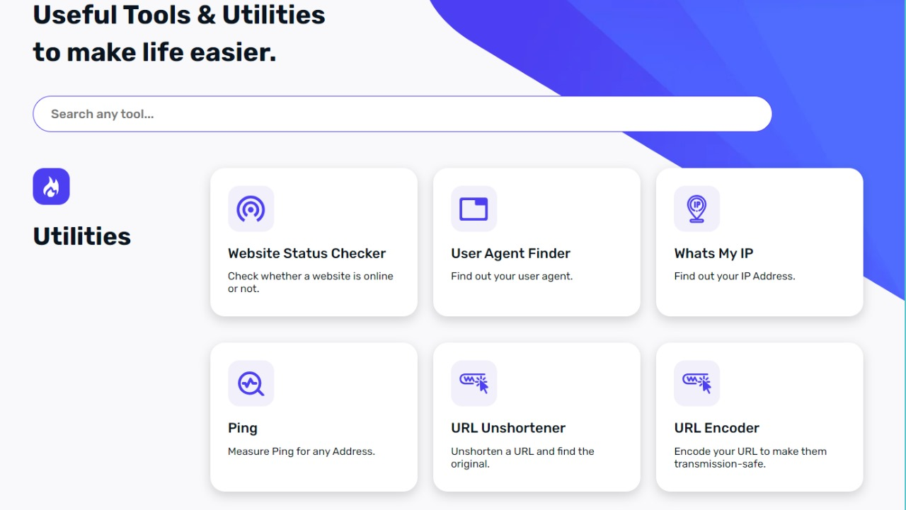
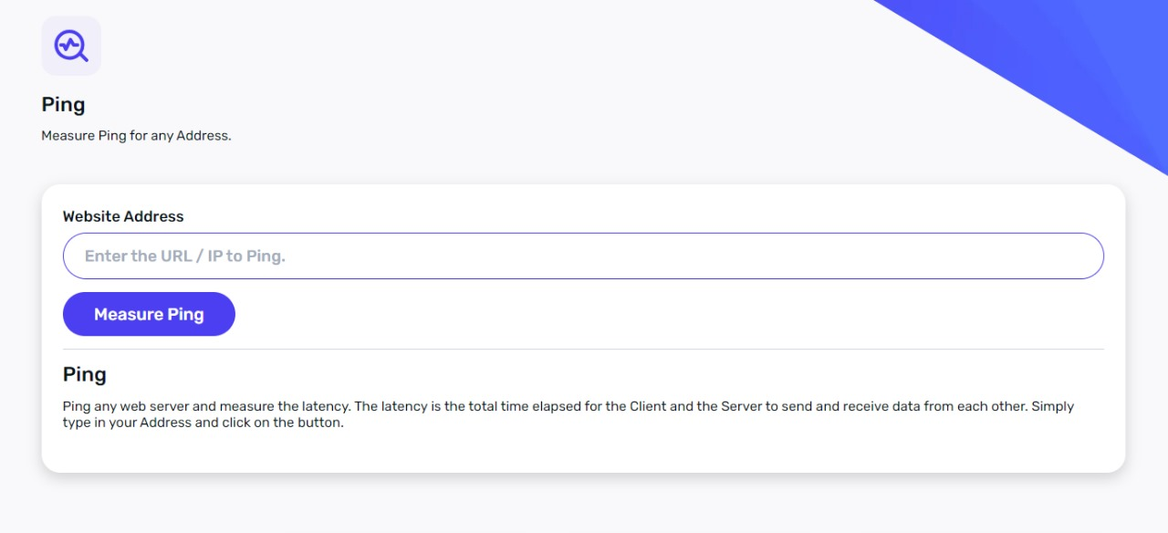

Proposed GUI
Department of AIML Engineering, LoGMIEER, Nashik

Slide 15
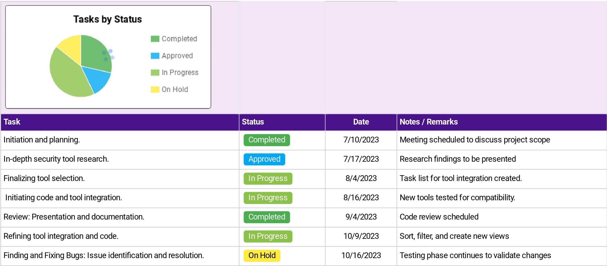
Project Plan
Department of AIML Engineering, LoGMIEER, Nashik

Slide 16
Conclusions
Conclusion 01
Conclusion 02
CyberSecure Hub is a game-changer in cybersecurity, offering diverse tools, user-friendly interface, advanced threat detection and user training.
It's your strategic partner for a secure digital future.
Department of AIML Engineering, LoGMIEER, Nashik

Slide 17
References
[1] J. Lee, S. John. (2020). "CyberFusion: Integration for Real-time Anomaly Detection."
[2] S. Patel, R. Mohim. (2021). "ThreatHub: An Integrated Threat Intelligence Hub for Informed Decision-Making."
[3] Kim Jon, Hetal. (2023). "APIGuardian: Seamless API Security for Enhanced Tool Communication."
[4] Ammrish Singh, Yogeswaran Nathan. (2021). "EAGLE :GUI-Based Penetration Testing Tool for Scanning and Enumeration."
Department of AIML Engineering, LoGMIEER, Nashik

Slide 18
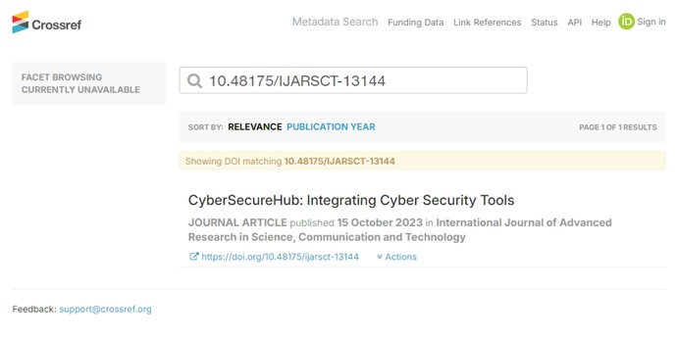
Proofs of Project Competition Participation
https://www.researchgate.net/publication/374749734_CyberSecureHub_Integrating_Cyber_Security_Tools
https://ijarsct.co.in/Paper13144.pdf
Department of AIML Engineering, LoGMIEER, Nashik

Slide 19



Thank you
www.CyberSecureHub.com
Department of AIML Engineering, LoGMIEER, Nashik

